Slide 1
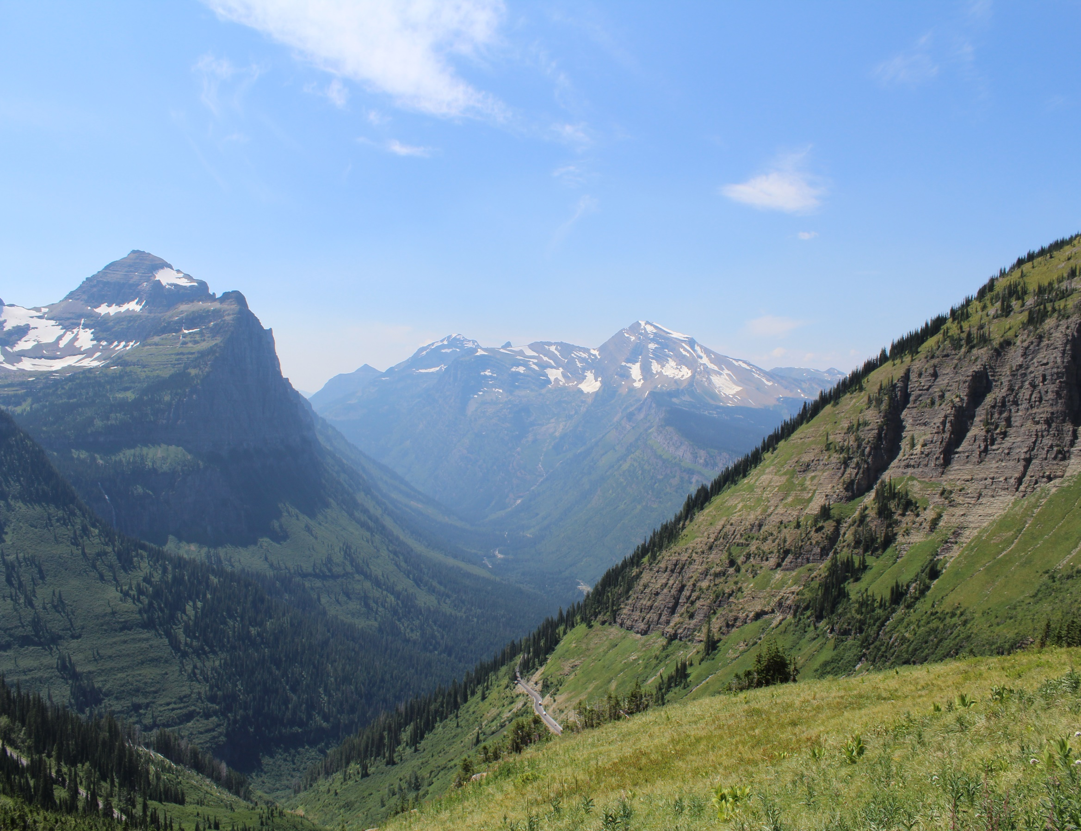
Linear Mixed Effects Models
a.k.a. Dealing with non-independence in your data
Leander Anderegg
Jan 22, 2024
*Thanks also to Dr. Ailene Ettinger and Dr. Ian Breckheimer for slides

Slide 2

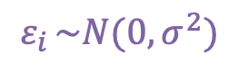
5min Prior Knowledge Primer
'Linear Models’ – most modern statistics = extensions of a linear model.
Response ~ Beta * Predictor + Intercept + Error
$$Y_{i} \sim β∗X_{i}+α+ ε_{i}$$
$$ε_{i }\sim N(0,σ^{2})$$
More predictors? → add Betas
Not linear? → ‘link function’ to transform to linear space
Error not normal? → fit a different error dist

Slide 3

5min Prior Knowledge Primer
'Linear Models’ – most modern statistics = extensions of a linear model.
What about classical ANOVA territory?
$$Y_{i} \sim α_{Bavarian}$$
$$+β_{central} ∗ X_{i central}$$
$${+ β}_{Emm} ∗ X_{i Emm}$$
$$+ …[others]+ε_{i}$$
Most ‘classic’ statistics are just special cases of linear models!

Slide 4
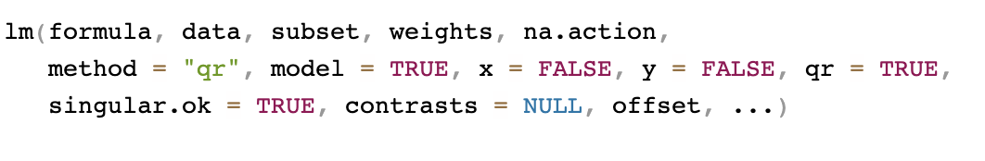
lm() Function Deep Dive
– Workhorse linear model fitting function in {stats} (i.e. don’t have to load any packages)
formula: The specification of the model you want to fit, in the form
ResponseVariable ~ Predictor1 + Predictor2 +…
data: A data frame object, with:
rows = each observation (i.e. one ResponseVariable data point)
columns = ResponseVariable plus a column for each predictor
subset: a Boolean statement about how to subset ‘data’
weights: a vector or column name in ‘data’ with weights for each data point
* Go to Code Example

Slide 5

‘Mixed’ Models
Models that acknowledge structure or non-independence in your data
$$Y_{i} \sim β∗X_{i}+α+ ε$$

Slide 6
‘Mixed’ Models
Models that acknowledge structure or non-independence in your data
$$Y_{i} \sim β∗X_{i}+α+ ε$$

Slide 7
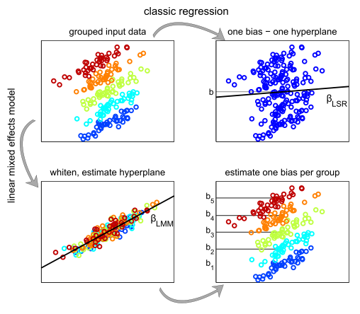
‘Hierarchical’ modeling, because random effects are drawn from a distribution set by a ‘hyperparamter’. Instead of estimating each b_{n} you estimate the DISTRIBUTION of bs!
Fazli et al. 2011

Slide 8
Mixed-effects Models: Why use them?
Nuisance factors contribute variability to your experiment, potentially masking or amplifying the variability associated with treatment groups
Pseudo replication:
Individual plants grown in trays and placed in chambers
Are the individuals, trays, or chambers your experimental unit?
Spatially nested:
Interested in the impact of a particular reading curriculum on students, which are nested within a classroom, within a district.
Repeated measures of an individual over time (not decades)
Assuming there is some independence, but not total independence, among individuals in a group (tray, chamber, school, etc.)
Unbalanced data (sample size varies among treatments)

Slide 9
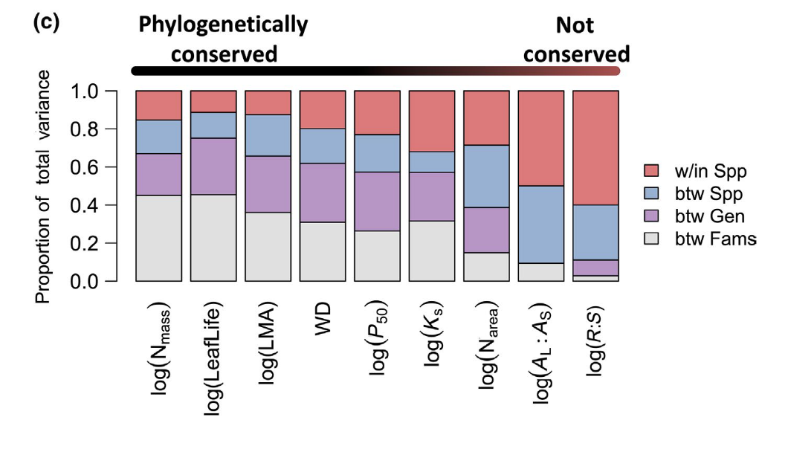
Mixed-effects Models: Why use them?
Interested in the variance associated with a particular factor.
Genotypes randomly selected from a population:
To what degree do they vary in response to a particular environmental parameter
Variance Decomposition:
You can partition variance using the variance estimates of hyperparameters
Anderegg et al. 2021

Slide 10
Fixed vs. Random Effects
Fixed effects
Fit parameters, factors of interest in a model
“Repeatable” levels
Treatments in an experiment
Random effects
Random samples from a larger population of interest
Non-repeatable
A grouping factor (blocks in an experiment, patient in a long-term study)

Slide 11
Real Example: Tree Rings and Range Boundaries

Slide 12
Example: Tree growth at Mt. Rainier
What climate variables affect tree growth?
Fixed effects?
Climate variables:
Temperature (MAT)
Precipitation (PPT)
Snow (SWE)

Slide 13
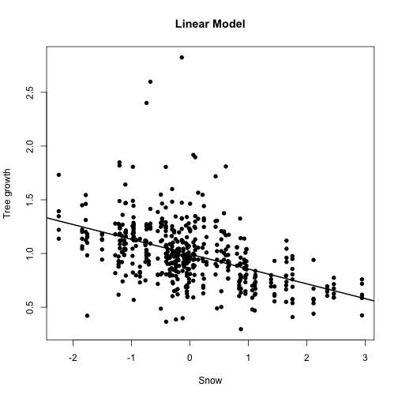
Example: Tree growth at Mt. Rainier

Slide 14
Example: Tree growth at Mt. Rainier
What climate variables affect tree growth?
Fixed effects?
Climate variables:
Temperature (MAT)
Precipitation (PPT)
Snow (SWE)
Random Effects?
Individual tree

Slide 15
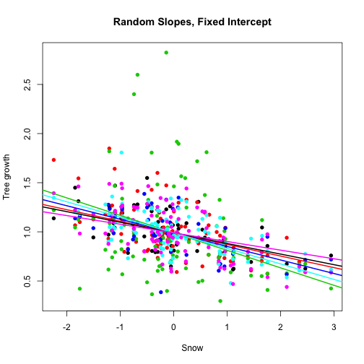
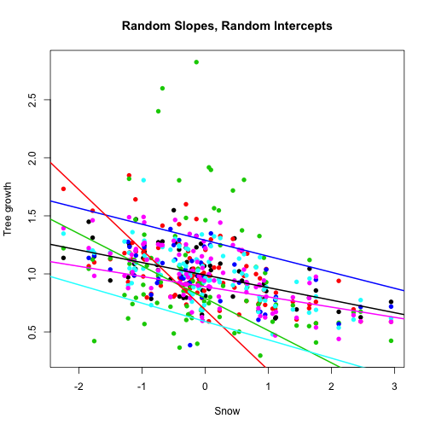
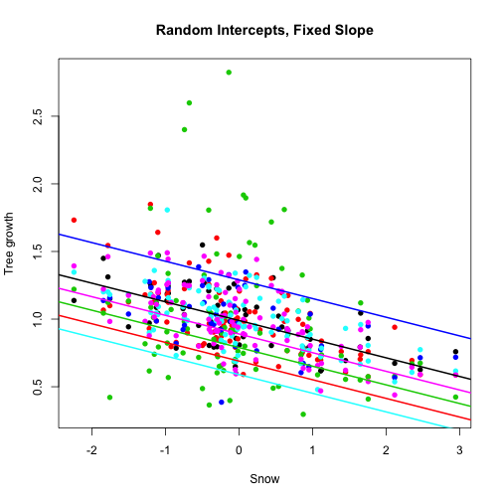
Random Effects can:
Have Random Slopes
Have Random Intercepts
Have Random Slopes AND Intercepts
You specify this in how you code the model

Slide 16
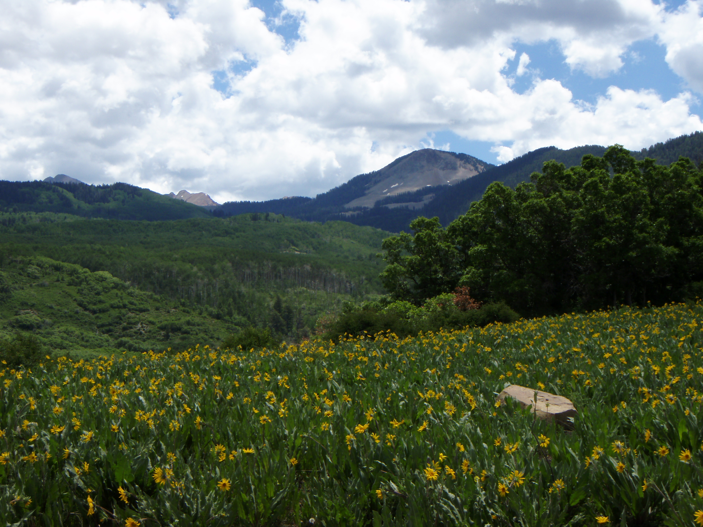
Example: Trade-off between climatic and biotic range constraints (assessed from tree rings)?

Slide 17
Stress Tradeoff Hypothesis
Fitness is constrained by climate in harsh environments and by species interactions in benign environments
(Brown 1996, MacArthur 1972, Dobzhansky 1950, Darwin/Wallace)
Climatic vs. Biotic
(physiology) (e.g. competition)

Slide 18
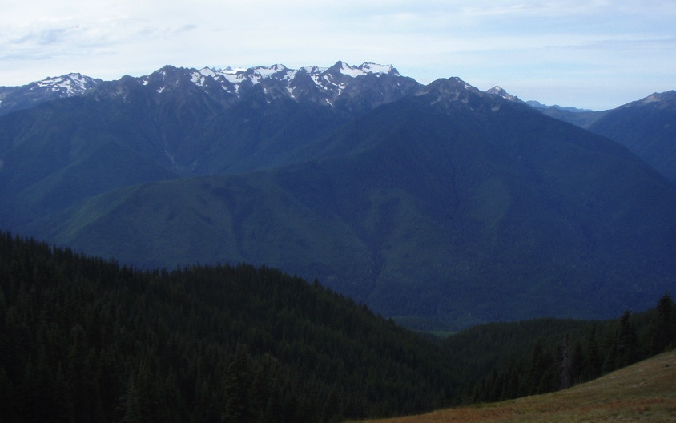
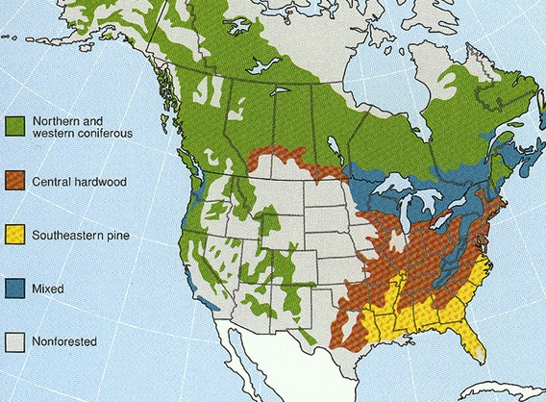
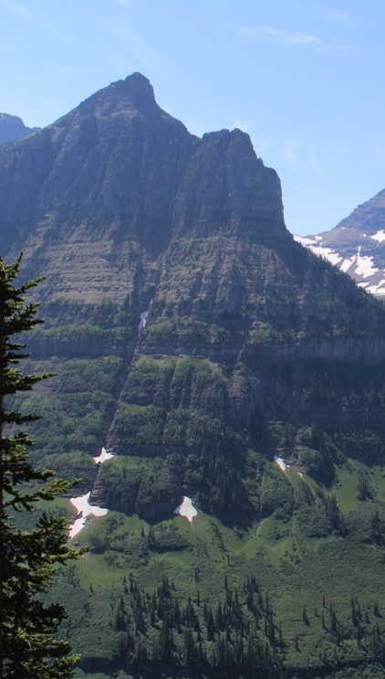
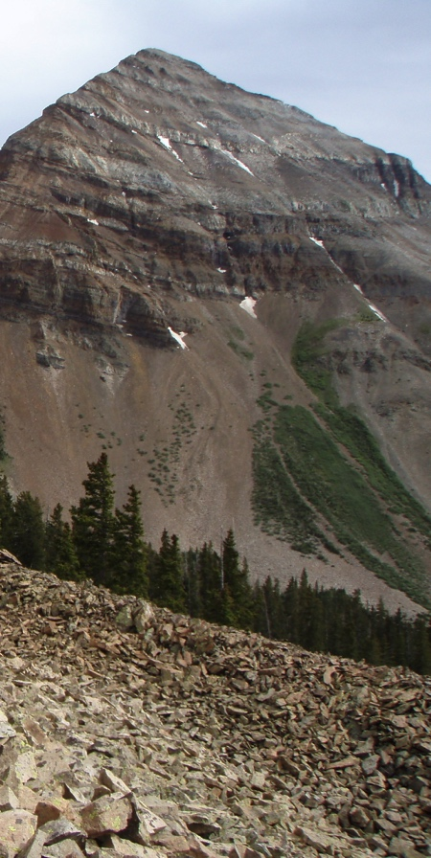
Washington
Montana
Colorado
geo.msu.edu

Slide 19
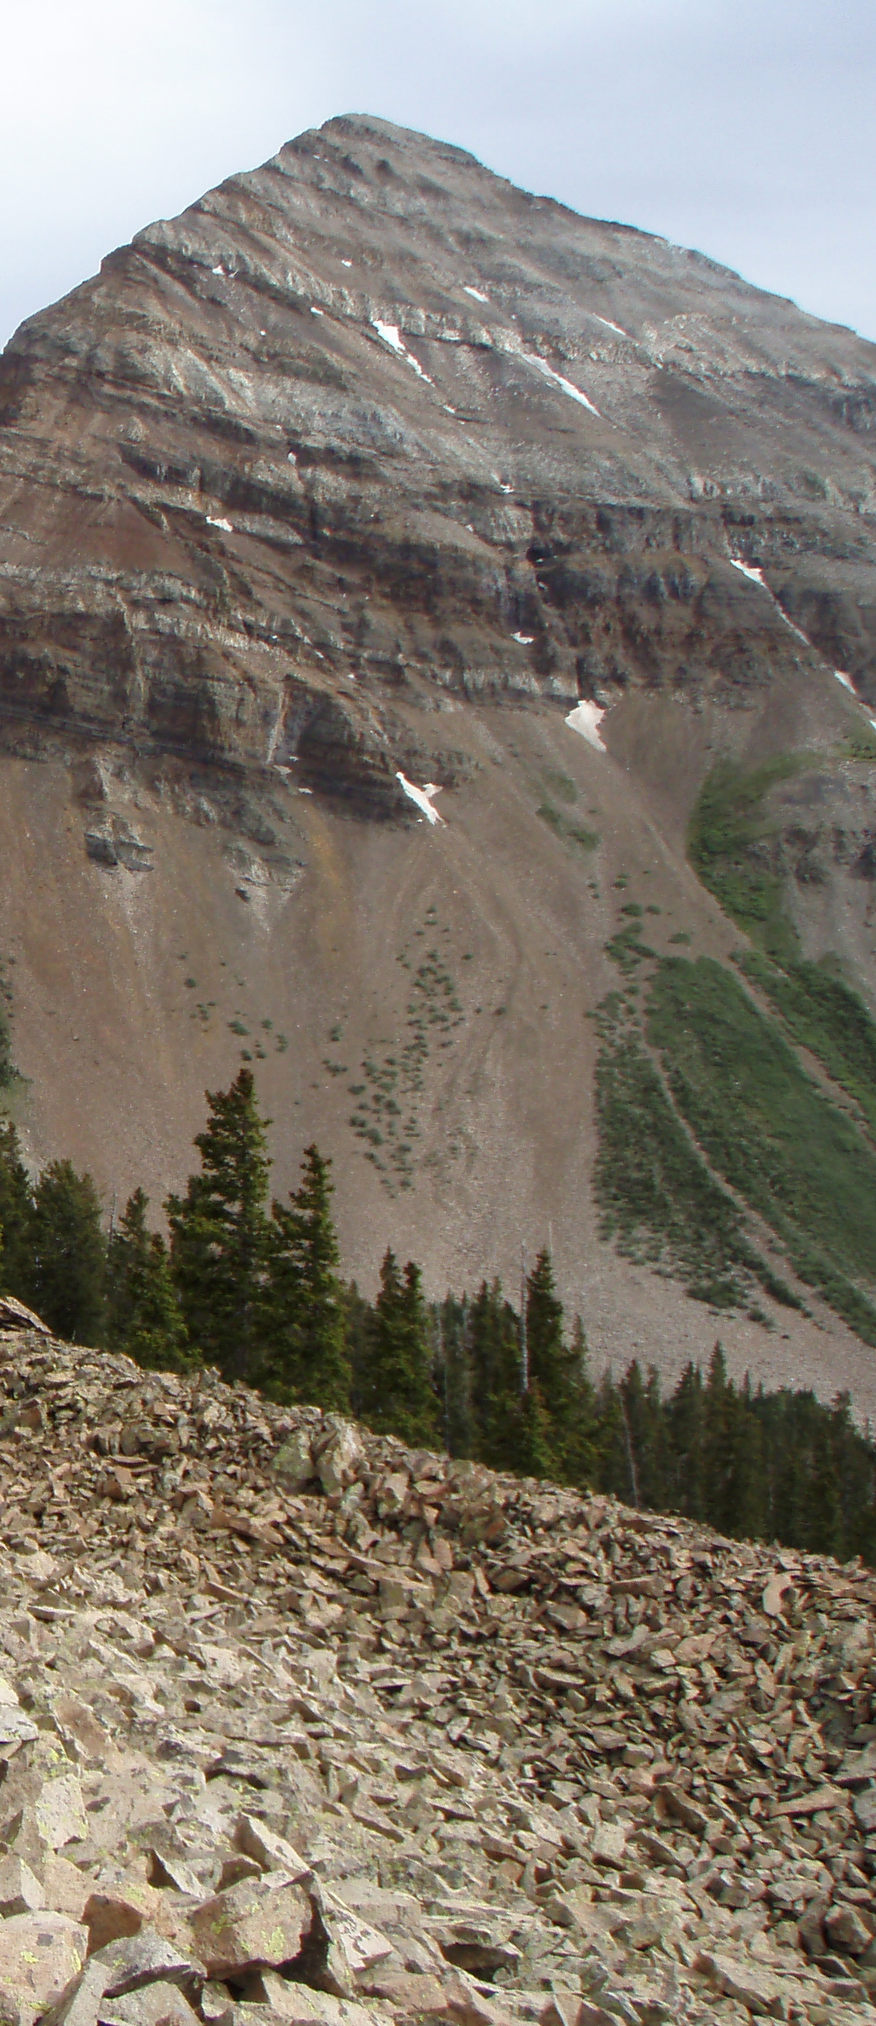
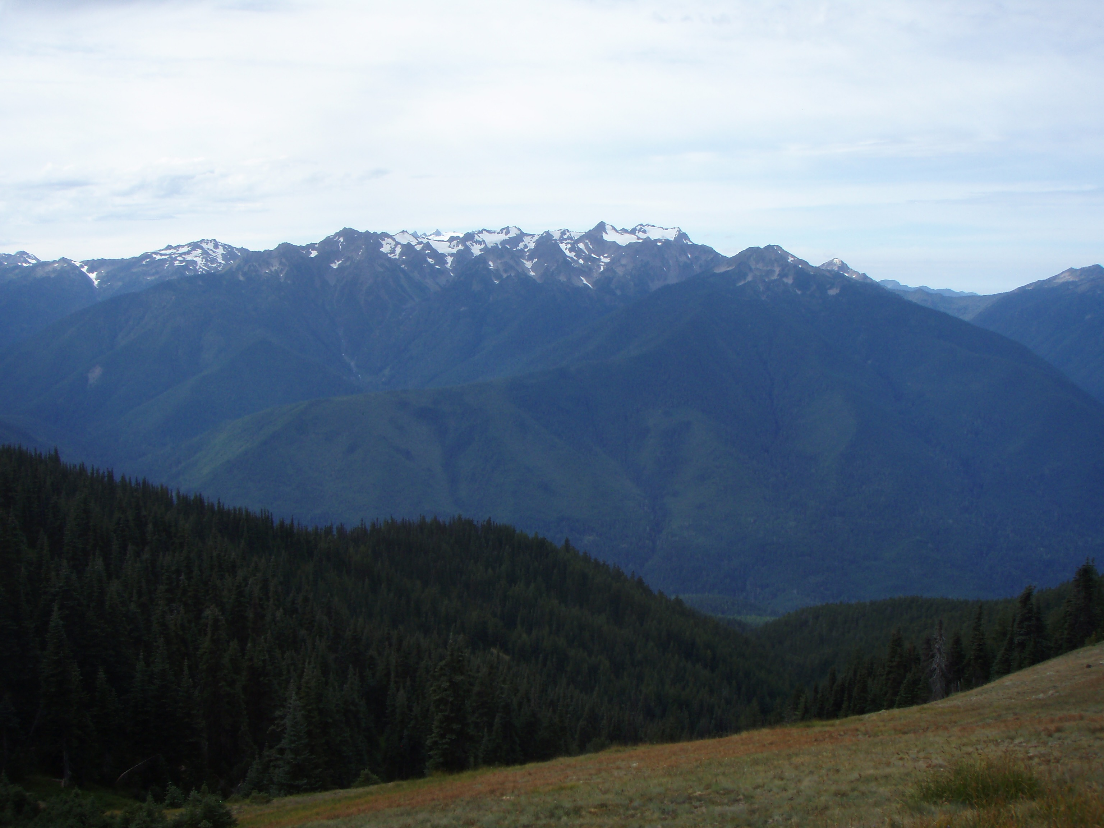
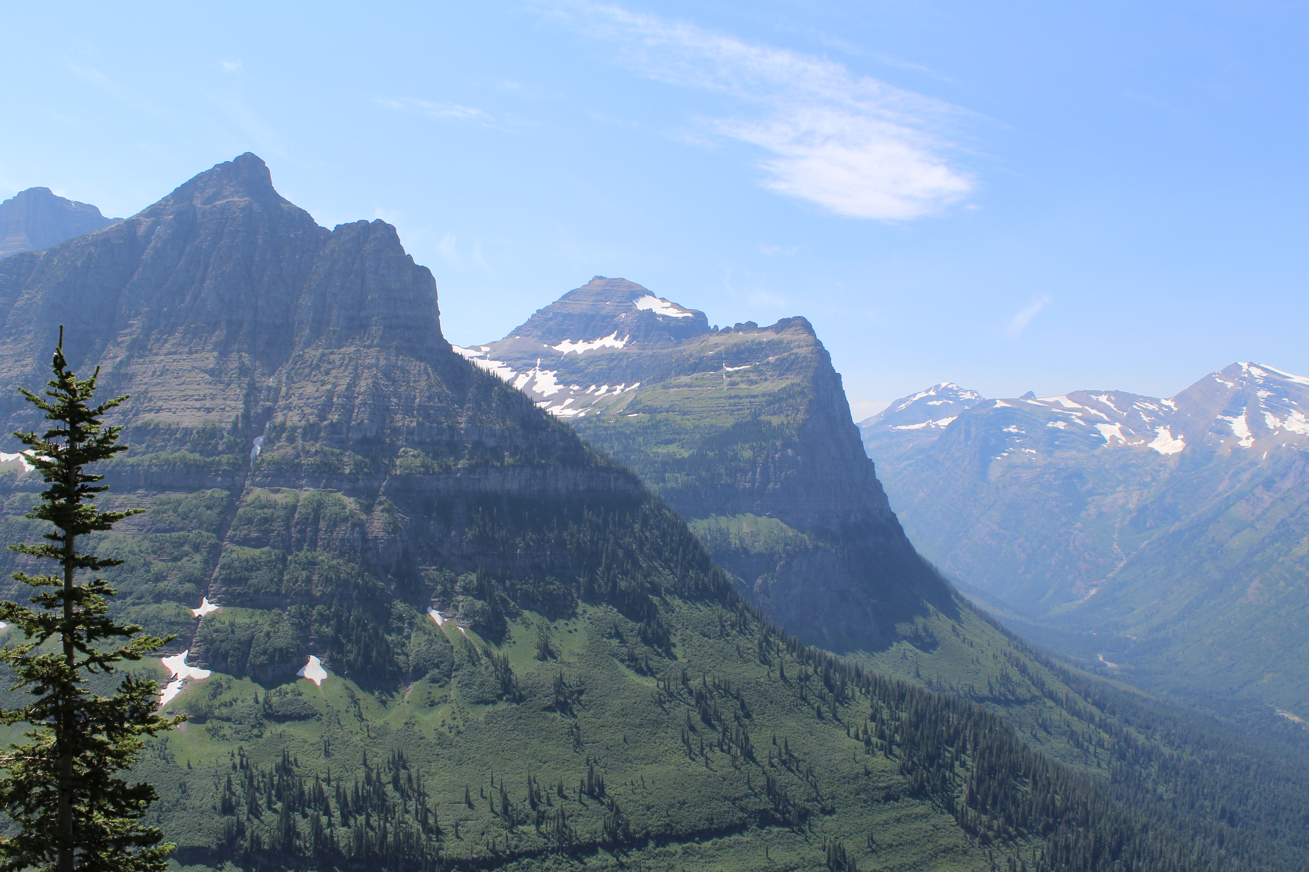

Slide 20
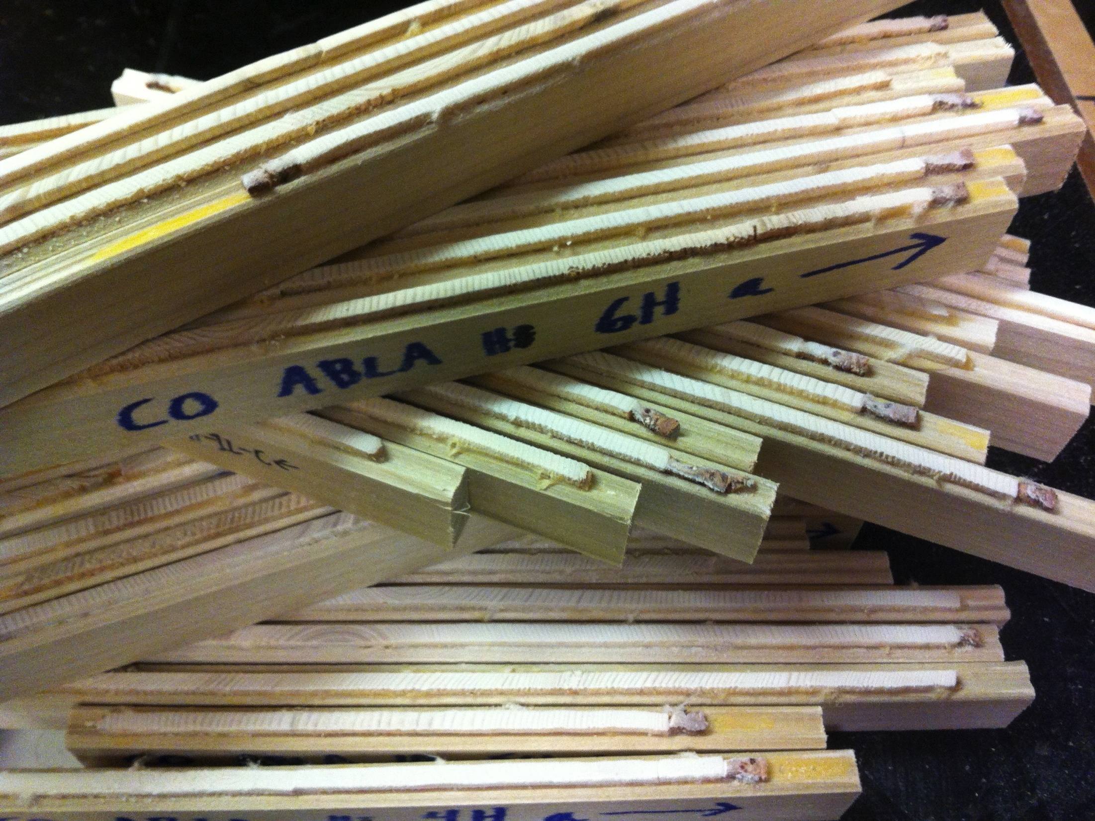
Tree rings
=
natural time machines
20
Notes:
for a species compare the dynamics of growth at it’s high and low elevation range margins to the range center

Slide 21
1. Environmental Harshness
(Mean growth rate for each population)
2. Growth sensitivity to Competition
(Slope of Growth~Stand Density line)

Slide 22
1. Environmental Harshness
(Mean growth rate for each population)
2. Growth sensitivity to Competition
(Slope of Growth~Stand Density line)
3. Growth Sensitivity to Climate
(Growth Synchrony between trees in a population)

Slide 23
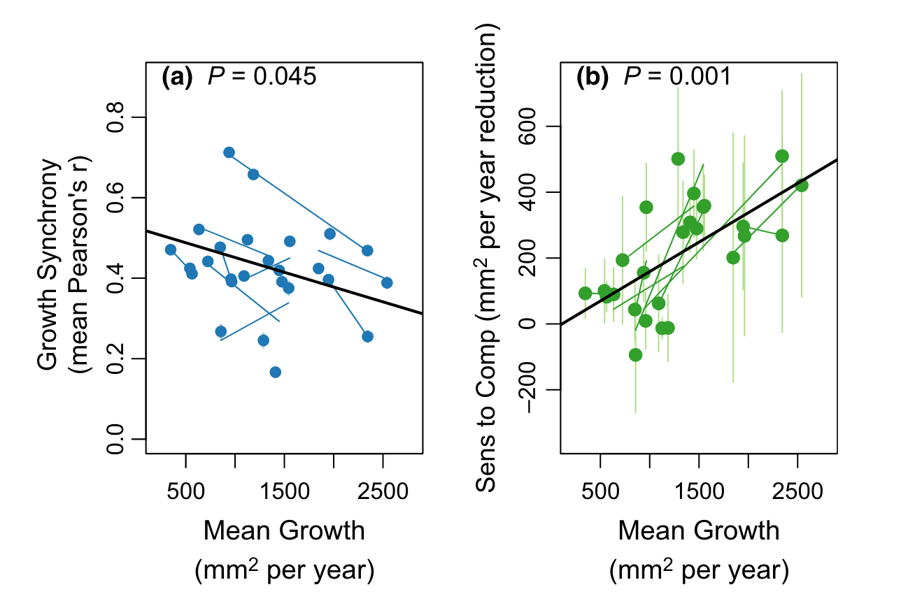
Broad scale evidence for a climatic-biotic trade off
Anderegg & HilleRisLambers, 2019

Slide 24
A few other notes on random effects
Can be nested or crossed
The coding is exactly the same in lmer, as long as you have unique identifiers for each random effect (e.g. tree number)
(fixed-effect parameter|random effect)

Slide 25
How are random effects estimated?
REML (restricted or residual maximum likelihood)
takes into account the loss of df due to estimation of the regression parameters
ML (maximum likelihood)
To compare models with different fixed effects, use ML (Note: REML is the default in lmer)
To compare models with the same fixed effects, but different random effects, use REML
Both REML & ML assume random effects & error are normally distributed

Slide 26
Resources
Mixed Effects Models List Serve/Douglas Bates
r-sig-mixed-models@r-project.org
Zuur et al. Mixed effects models and extensions in ecology with R.
Articles in the github repo
Lme4: Mixed-effects modeling with R. (Bates’ book)

